Slide 1
M3D-RPN
Monocular 3D Region Proposal Network for Object Detection
2021.08.31

Slide 2
Backgound and Contribution
Background
expensive LiDAR
external state-of-the-art (SOTA) sub-networks
Contribution
formulate a standalone monocular 3D region pro_x0002_posal network (M3D-RPN)
propose depth-aware convolution
propose a simple orientation estimation post-optimization algorithm
achieve state-of-the-art performance on the urban KITTI benchmark

Slide 3
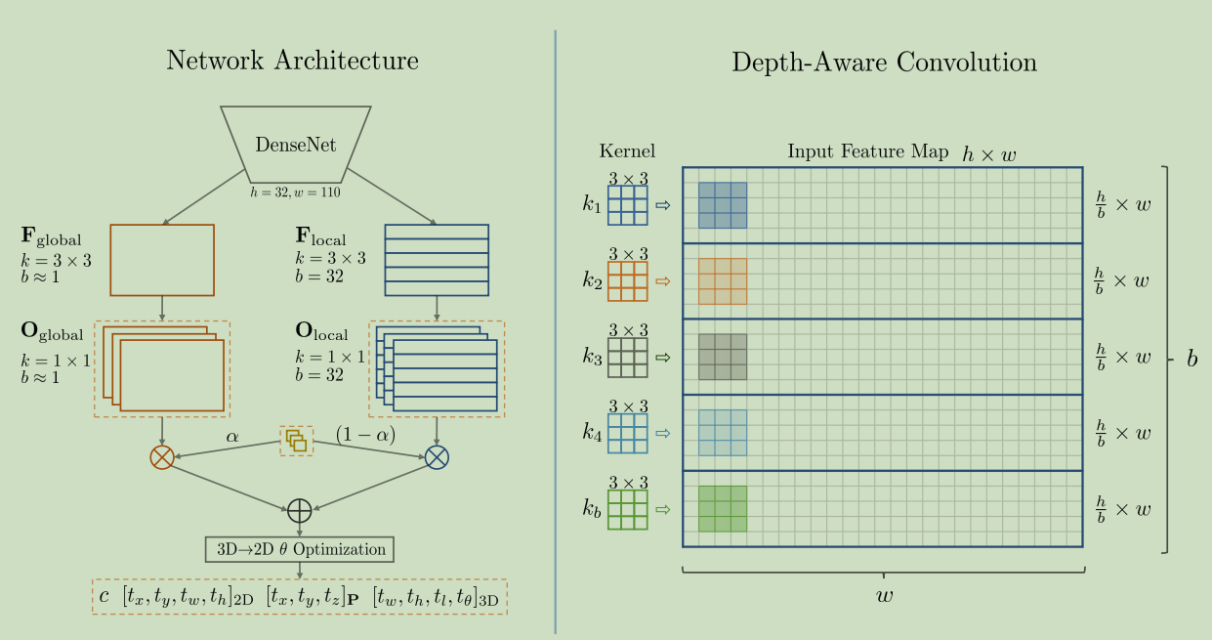
Network Architect
Fig. 1 Overview of M3D-RPN

Slide 4

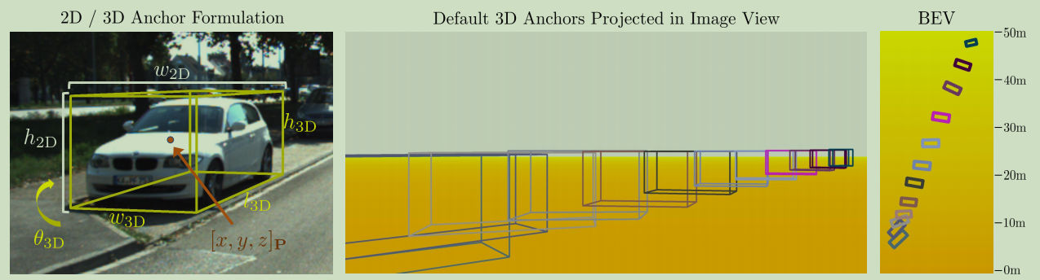
1. Formulation
Based on RPN in Faster R-CNN
Anchor Definition
prior
Fig. 2 Anchor Formulation and Visualized 3D Anchors

Slide 5













1. Formulation
3D Detection
Image space Camera coordinates
Loss Definition
model output prediction
transformed
model output prediction
transformed

Slide 6
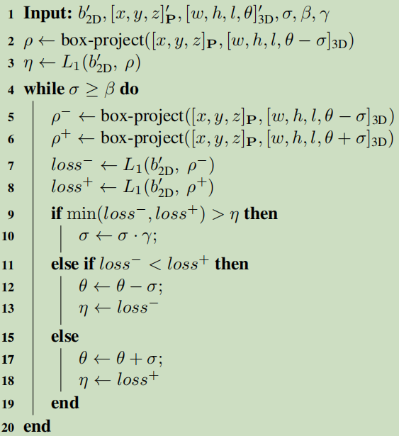

2. Depth-aware Convolution 3. Post 3D→2D Optimization
Depth-aware Convolution
go to Fig. 1.
Post 3D→2D Optimization
optimize the orientation parameter θ
Algorithm 1: Post 3D→2D Algorithm.

Slide 7
Experiments and Results
KITTI [15] dataset
Bird's Eye View (BEV) and 3D Object Detection
Average Precision (AP) and Intersection over Union (IoU)
Collectively, they significantly improve the performance on the challenging KITTI dataset on both the Birds Eye View and 3D object detection tasks for the car, pedestrian, and cyclist classes.

